Slide 1


The Right To vote:
Three common obstacles faced by voters with disabilities, with essential details & facts to address & eliminate them.
Presented by Shirley Walker-McKinnis – Voting Rights Coordinator, and Greta K. Martin – Litigation Director and Civil Rights Attorney Both on staff at Disability Rights Mississippi
Notes:
A couple comments about our work and DRMS.

Slide 2


The mission of DRMS is to promote, protect and advocate for the legal and human rights of all persons with disabilities and to assist them with full inclusion in home, community, education and employment.
Notes:
Who we are and what we are,,, Been providing legal advocacy, free of charge for 37 years, for people with disabilities. DRMS is federally funded and designated by the Governor of Mississippi to protect and advocate for people with disabilities. The organization is governed by a board of directors and plans its priorities and services based on input from the public.
It is a private, non-profit and receives NO state funds. P & A’s (short for Protection and Advocacy) were established by Congress to protect the rights of people with disabilities through legal support. There are 57 P & A's. Collectively, that makes us part of the largest network of providers of legal advocacy services to people with disabilities in the United States. With all of the services that we offer, why is voting rights a focus of the agency?
As a non-profit, we have goals and priorities and obligations to make sure that, in all the work we do, we are promoting/facilitating stronger, healthier, better communities in the state of MS. That’s a common goal all non profits have; a standard they are held to. And as a disability focused agency, we believe that in order to have stronger, healthier, and better communities then they must also be inclusive and engaged communities!
And we stand by the opinion or concept, that one of the most fundamental ways a person can be a part of their chosen community it to take part in their civic life – have their voice heard, and vote. But there are still issues that present challenges and obstacles today, and part of our work, our mission, is to ensure that we do what we can to assist in lessoning and ultimately, eliminating these electoral barriers that ultimately contribute to inclusive communities.

Slide 3


Voting Grant at DRMS (PAVA)
The Protection and Advocacy for Voting Access (PAVA) program was created by the Help America Vote Act (HAVA) of 2002.
Notes:
Before we discuss the issues that voters with disabilities face, we’ll discuss the laws on which all the answers to problems are based. The Help America Vote Act (HAVA) of 2002 was passed by the United States Congress to make sweeping reforms to the nation's voting process. HAVA addresses improvements to voting systems and voter access that were identified following the 2000 election. It was signed into law on October 29, 2002 Provides grants to states, and one of these is to the P & A’s to assist individuals with disabilities in the voting process. As part of our federal mandate, DRMS receives funding from the Help America Vote Act through the Administration for Community Living in the U.S. Department of Health and Human Services to ensure full participation in the electoral process for individuals with disabilities. Under this grant, DRMS identifies barriers to each step of the voting process. From accessible parking and appropriate signage, to properly functioning Ballot Marking Devices and ensuring people have the correct information about their rights. We are advocating for your access to cast your vote privately and independently.

Slide 4
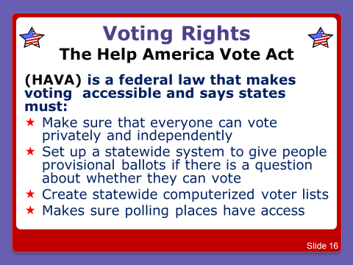

Notes:
requires jurisdictions responsible for conducting federal elections to provide at least one accessible voting system for persons with disabilities at each polling place in federal elections. The accessible voting system must provide the same opportunity for access and participation, including privacy and independence, that other voters receive.

Slide 5
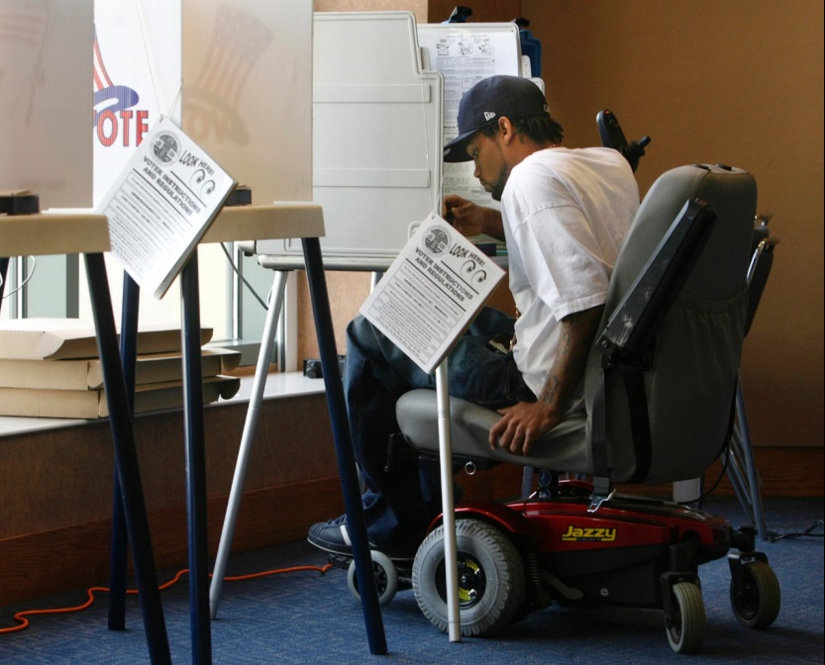
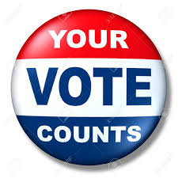
Protection & Advocacy under the Help America Vote Act
DRMS advocates:
* Provide voting rights training *Conduct polling site surveys *Host a hot-line on election days *Provide information to election officials *Participate with other P & A’s to create innovative ideas to fight rights violations
Notes:
HAVA was a big leap forward in terms of voter access. It created the U.S. elections assistance commission which has tons of helpful resources on their website. It created the voluntary voting system guidelines. This makes sure systems are accessible.
But just as much as the HAVA Act has impacted our voting work, there are older laws that laid the groundwork, the framework to issues and rights that help us with this work.
We’ll start with the Voting Rights Act of 1965 -

Slide 6
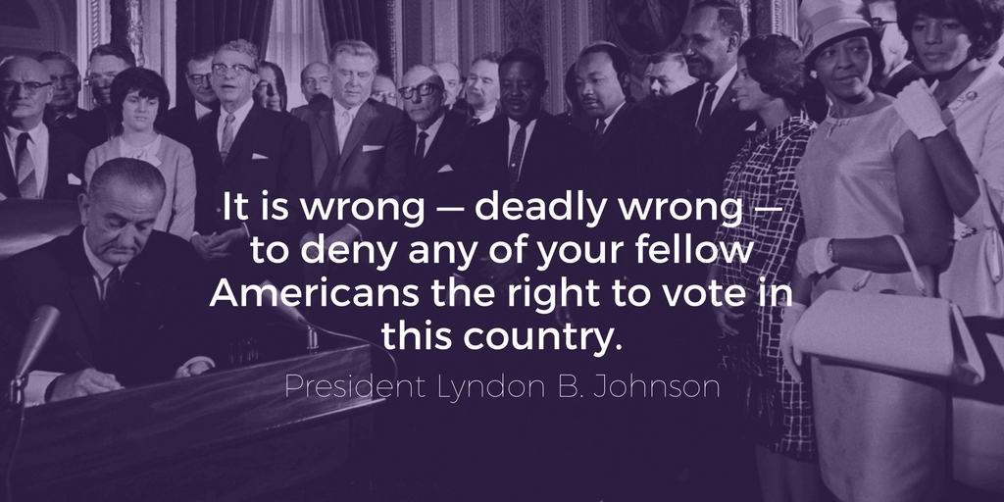
The Voting Rights Act of 1965
Notes:
is generally considered the most successful piece of civil rights legislation ever adopted by the United States Congress. The Act codifies and effectuates the 15th Amendment's permanent guarantee that, throughout the nation, no person shall be denied the right to vote on account of race or color. Even though the VRA primarily is noted for addressing race, it also contains provisions relevant to the voting rights of people with disabilities. The VRA requires election officials to allow a voter who is blind or has another disability to receive assistance from a person of the voter’s choice (other than the voter's employer or its agent or an officer or agent of the voter's union). The VRA also prohibits conditioning the right to vote on a citizen being able to read or write, attaining a particular level of education, or passing an interpretation “test.”

Slide 7
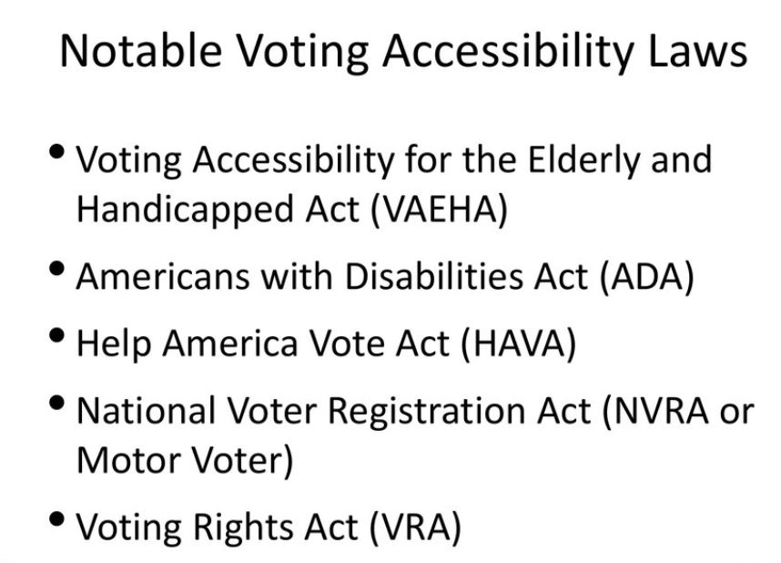
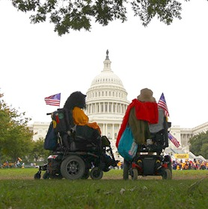
Notes:
The Voting Accessibility for the Elderly and Handicapped Act of 1984 generally requires polling places across the United States to be physically accessible to people with disabilities for federal elections.

Slide 8
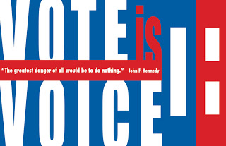
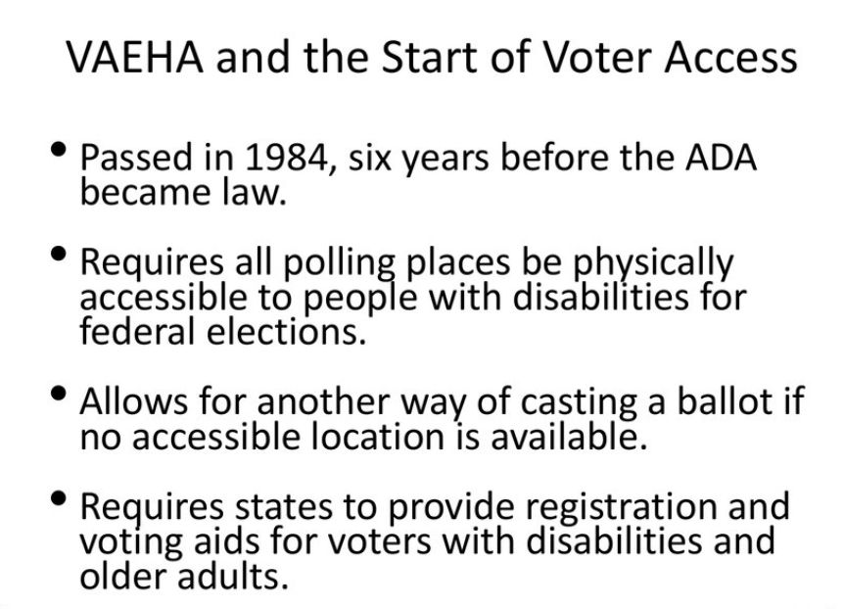
Notes:
The voting accessibility for the elderly and handicapped act. This act is truly where voter access starts in the United States. First, it was passed in 1984. Before this passed in 1984, we didn't have federal laws guaranteeing elections will be accessible. Also, it comes 6 years before the American with disabilities act which didn't become law until 1990. This truly is a beginning. This act requires all polling places are physically accessible to people with disabilities for federal elections. Skip forward to 1990 and talk about the ADA, the Americans with disabilities act. This is huge when it comes to voter access. The ADA is one of the largest and most sweeping pieces of civil rights legislations to pass in the United States. It lays out the architectural access. This is a piece of legislation that says if you have stairs, you have to have a ramp or elevator. All of those standards, of which there are many, apply to polling places.
So through the culmination of all of these voting provisions in each of these laws:
We inform people of their voting rights and provides them with accessible voter information
We provide people with the opportunity to register to vote
We provide individual and systemic advocacy
We provide training and education programs to increase informed voting in the community
We ensure that people, regardless of disability, have the opportunity to vote
We can provide people with assistance in filing complaints when necessary

Slide 9
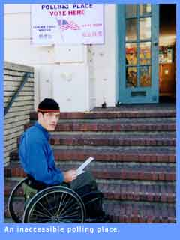
Even though we have these laws, mandates, and amendments,,,
Barriers to equal rights at the ballot still exist for people with disabilities!
Notes:
And here’s where the questions and issues come up. With all these laws and protections in place for voters with disabilities, there are still complications, misconceptions, and barriers they face in every election, from local to federal.
And basically today is just a summary of these complications and issues. So we’ve broken it down into 3 basic issues that we see are the most common barriers: 1. - Lack of current and correct information:
2.- Architectural and attitudinal barriers:
3. – Insecurity about the process: The issues are complex. But for the sake of time we’ll stick to these topics today. or try to.

Slide 10
Challenge 1 – Lack of Current & Correct Information:
*About registration and eligibility *About timelines, deadlines, and election dates in general
*About rights for assistance
*About how much a vote really does count – what’s at stake
Notes:
while people with disabilities have made tremendous political gains over the past few decades, most notably with the passage of the Americans with Disabilities Act (ADA) in 1990, evidence indicates that they are not yet full and equal participants in the American political system, raising concerns that they remain marginalized and their interests are often neglected by politicians and elected officials.”
And lack of information seriously inhibits their ability to actively and effectively self-advocate, or even participate. that’s why rights trainings are so important. Or calling an agency like ours when they have a question or concern.
We’ll start with Registration.

Slide 11
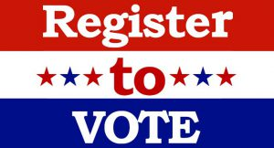
You must register to vote at least 30 days before election day!
Go to: http://www.sos.ms.gov/Vote/Pages/default.aspx
Call your local circuit clerk’s office
Call DRMS and we can help – 1-800-772-4057
Register here with us today! We have forms and will mail in for you!
PRIMARY ELECTION DAY for Statewide, State District, Legislative, County and County District Offices. Polling places open from 7:00 a.m. until 7:00 p.m. (Miss. Code Ann. § 23-15-1031)
Notes:
There are many people who don’t understand the registration process, or they have incorrect information about it and think they can register the day they cast their vote. This can get confusing b/c not every state does things the same way.
In MS this year, coming up,, you would have had to be registered by Oct. 8th to vote in the General, Gubernatorial election on November 5th.

Slide 12
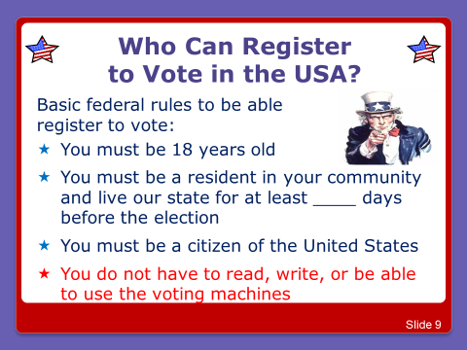
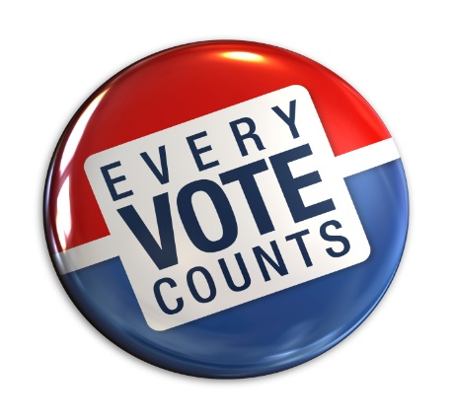
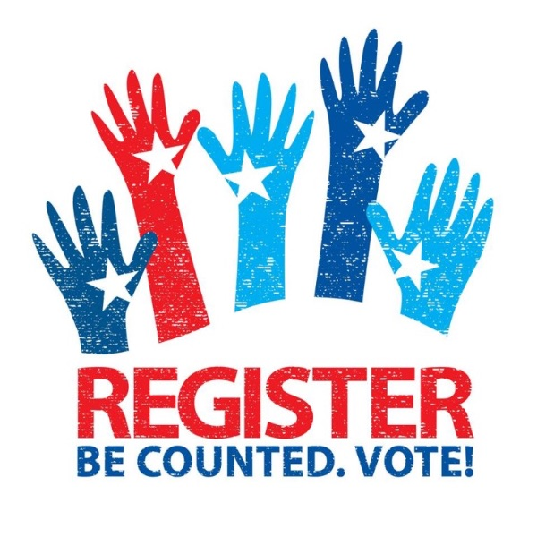
30
Notes:
and then there is also a list of crimes you cannot have been convicted of as well. There is a great deal of controversy regarding these laws as outlined in the MS constitution from many many years ago, with some amendments, additions, and changes made, but you can look them up if you have questions about them.

Slide 13
Eligibility
Guardianship?
While there may be good reasons for seeking that protection, one unintended side effect of declaring adults incompetent to deal with their own affairs may be a loss of voting rights. Don’t assume that is necessarily the case, though. In MS, a person only loses the right to vote if the judgement actually states them to be “non compos mentis” or if it specifically addresses losing the right to vote.
Notes:
Someone having guardianship or conservatorship over someone does not automatically mean they cannot vote. But the time to determine this prior to registering to vote, not on election day. If someone with a developmental disability goes to a polling site to cast a ballot, if a poll worker thinks they shouldn’t be voting, then that’s not for them to decide in that moment. If their name is on the voter roll, then they should be allowed to vote, and if it’s not on the voter roll they should be allowed to vote by affidavate ballot.

Slide 14
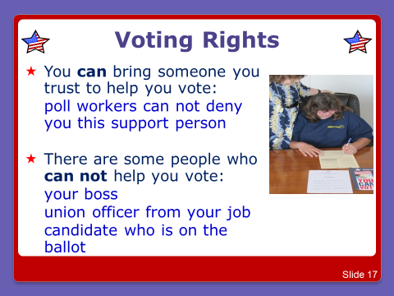


Slide 15
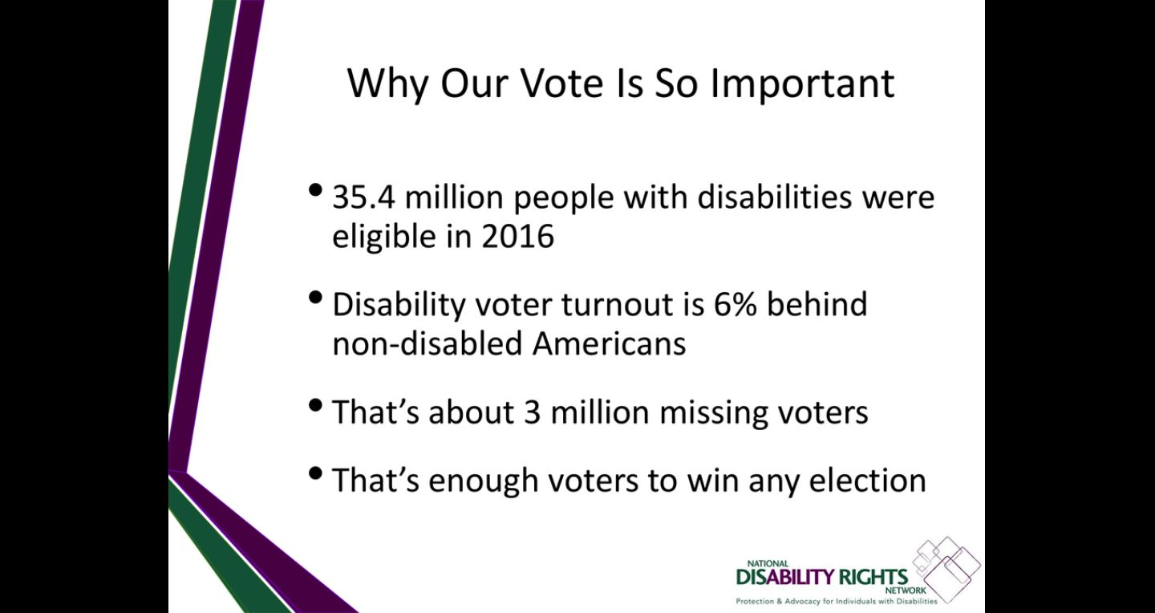
Notes:
In addition, just like being counted in the census is important,, who’s voting is also important and captures the voice of who’s in the community.

Slide 16
Challenge 2- Physical & Attitudinal Barriers:
* Lack of transportation * Inaccessible polling sites
* Discriminatory attitudes by poll workers, family members, or service providers (whether they mean to be or not)
Notes:
Once again,,, while people with disabilities have made tremendous political gains over the past few decades, evidence indicates that they are not yet equal participants in the American political system, raising concerns that they remain marginalized.
Marginalization can be understood as persistent inequality and adversity resulting from discrimination, social stigma and stereotypes, and just downright not being heard/considered. From inaccessible polling sites to information unavailable in minority languages, including ASL, to discriminatory laws, to a lack of access to information, - these are all factors that create significant barriers to entering the political process, and do exist.

Slide 17
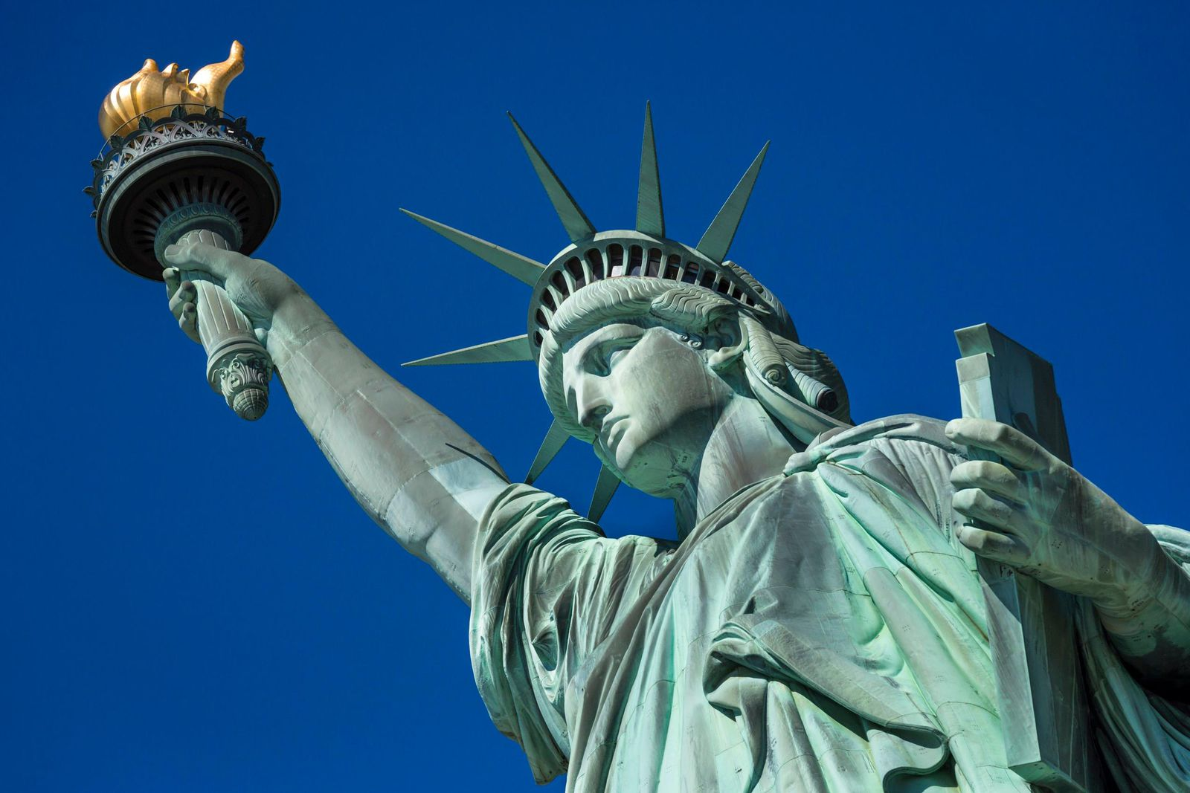
The right to vote is a fundamental liberty right!
“No right is more precious in a free country than that of having a voice in the election of those who make the laws under which, as good citizens, we must live. Other rights, even the most basic, are a losery if the right to vote is undermined!” - Justice Hugo Black
Notes:
Democracy is more likely to develop and endure when all segments of a society are free to participate and influence political outcomes without suffering bias or reprisal. But they have to be able to access it!

Slide 18
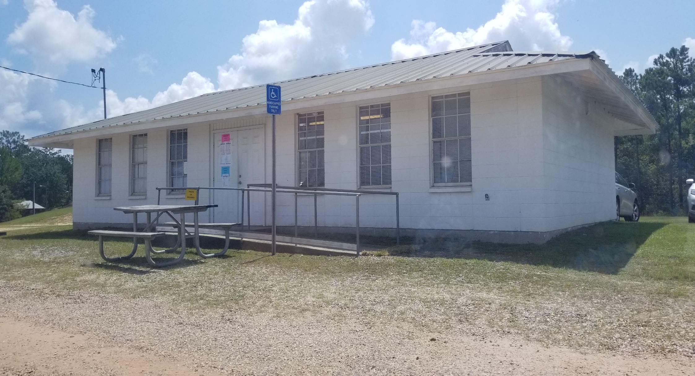
PHYSICAL ACCESSIBILITY
Photo taken in August of 2019.
Notes:
What do you notice about this picture? Gravel, rocky parking, a picnic table in front of the only accessible parking sign you see, a ditch and broken concrete at the entrance to the supposed accessible ramp, and not wide enough for an electric scooter or larger wheelchair. Drop off on the other side / end of the ramp,,, dangerous in general.
This picture was not taken 20 years ago,, or even 5 years ago. It was taken 2 months ago.

Slide 19
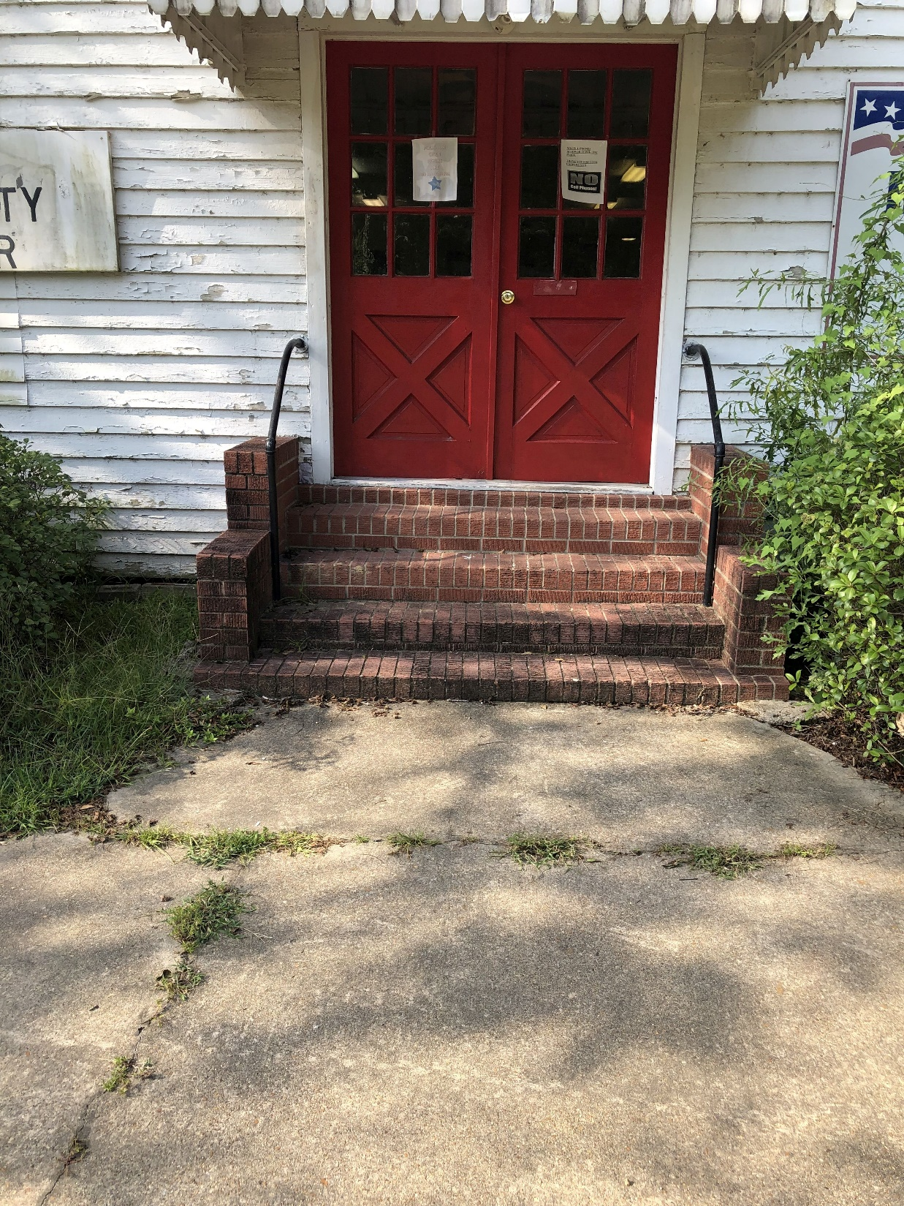
Photo taken in August of 2019.
Notes:
No ramp at all; no vote here signage; broken up pathway, no marked accessible parking.
Again,, just 2 months ago.

Slide 20
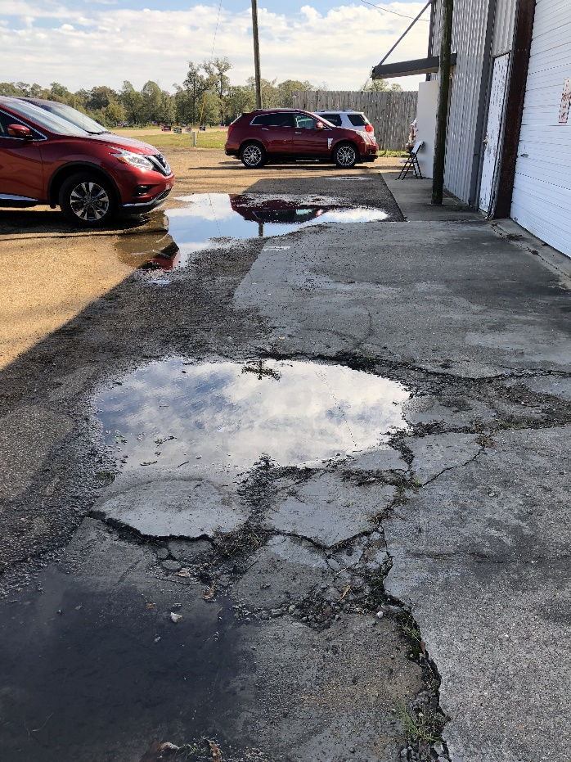
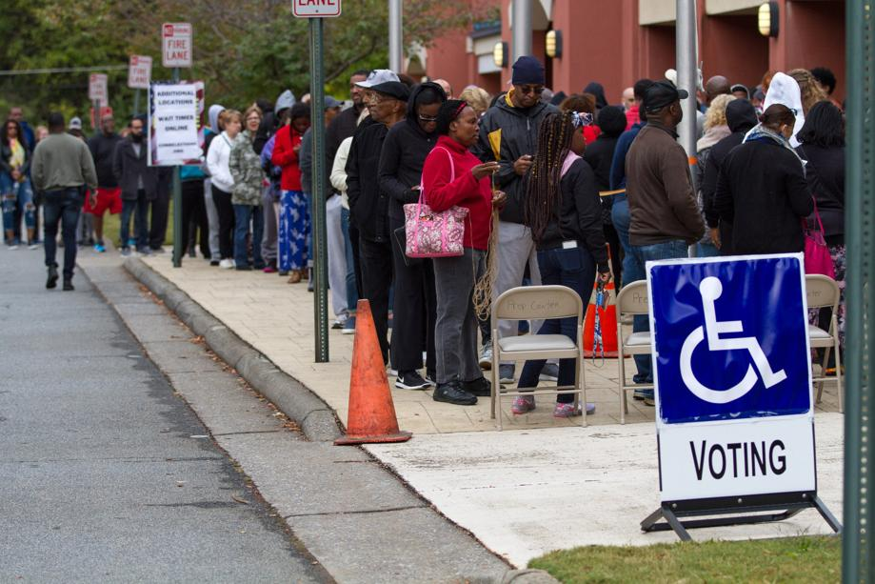
Five Common Physical ADA Access Problems at Polling Places
Parking
Sidewalks and Walkways
Entrances
Hallways and Pathways
Voting Areas
Notes:
In our polling site monitoring activities we can state that the these are the most common areas of concern in MS. Often we see polling sites with inadequate signage to even indicate that they are an active polling site location. Either signs are too far away from the road to be seen, stuck behind bushes and trees, or situated right in the middle of a bunch of political signs,, which most of us look for anyway, but shouldn’t have to. This lack of proper signage includes lack of signage indicating an accessible entrance, if there is one, or where designated accessible parking is. No curb cuts or ramps, or if someone is wanting to use curb site voting, they also have to have someone with them to notify a poll manager.

Slide 21

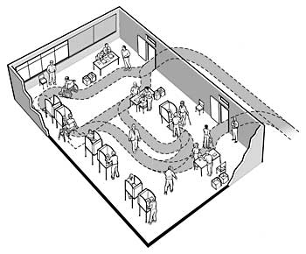
Notes:
Voting Accessibility for the Elderly and Handicapped Act of 1984requires election officials to make sure you have an alternate way to cast a ballot.
Most states will allow curbside voting (a poll worker runs a ballot out to you, and you complete it in your car) if you can't make it inside.
The law also requires the availability of voting aids for disabled and elderly voters. So don't be afraid to ask.

Slide 22
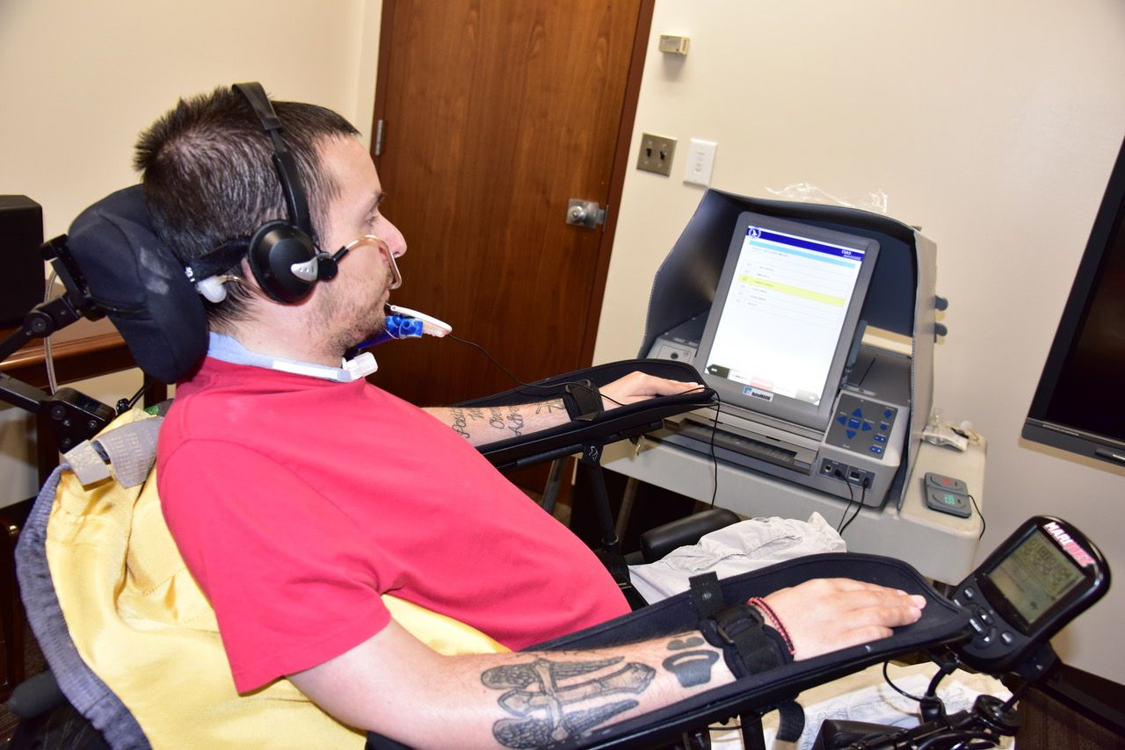
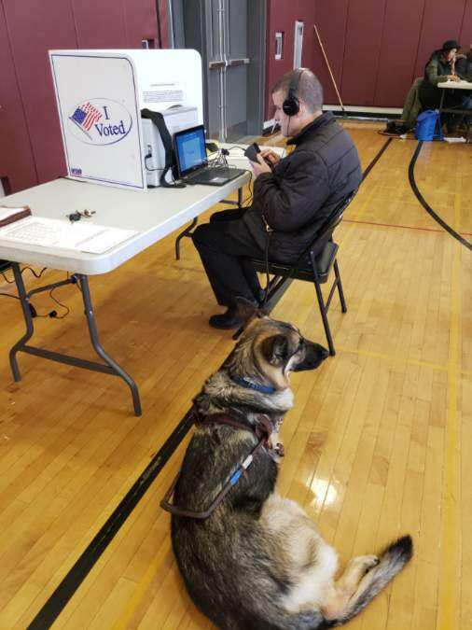
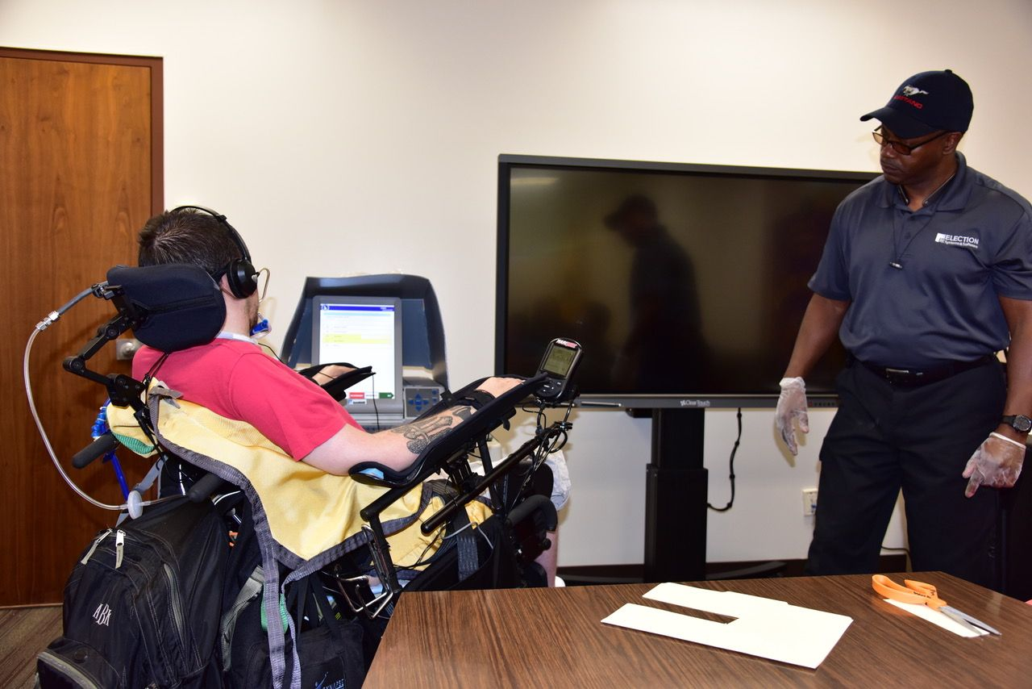
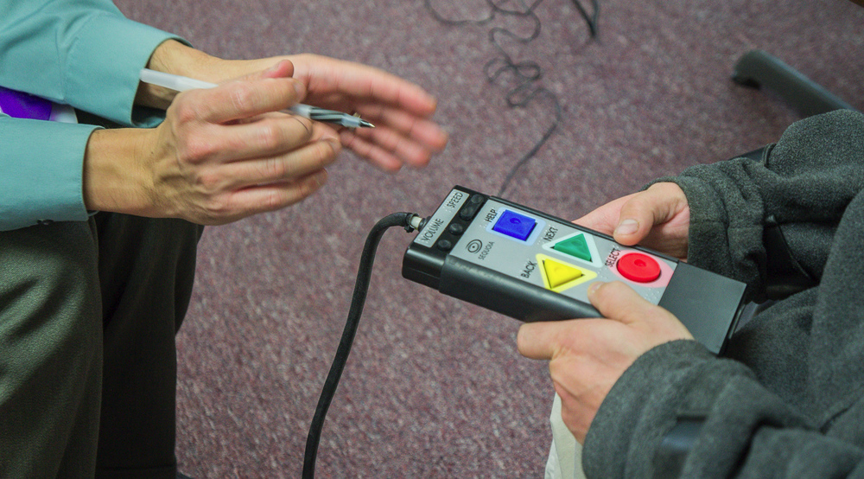
Notes:
IN the voting area itself, we find the most common problem to be that poll workers are intimidated by the accessible machinery or too uncomfortable with it to confidently set it up. But each site is supposed to have one.
In these pictures you see:
Mr. Adam Booker using the AutoMark with the sip and puff mechanism. If on election day you need to use an accessible device, and find that it is not working, or there is some problem that will prevent you from using the machine, then you need to contact DRMS at 1-800-772-4057 immediately.

Slide 23
Solutions and fixes need to start with considerations. Understanding how all voters arrive at the polls, park or drop people off, move through the facility and the voting area, and back out again will help identify physical barriers that will need to be remediated.
The Checklist, title II regulation, and the ADA Standards are available at www.ada.gov.
In addition, election officials should consult the Department’s 7-page publication on the rights of voters with disabilities, The Americans with Disabilities Act and Other Federal Laws Protecting the Rights of Voters with Disabilities, also available at www.ada.gov.
Notes:
While locating polling places in accessible facilities makes ADA compliance more likely, there may be times when that is not possible and the use of temporary measures to provide access will be necessary. But, these solutions or measures for inclusion won’t happen if voters with disabilities are not being considered, remembered. Included.

Slide 24
Challenge 3- Insecurity about the Process:
* Goes back to lack of information * Unsure of rights
* Experienced discrimination * Embarrassment
Notes:
For many people with disabilities, encounters with uninformed members of the public can be painful and embarrassing. The thought of having voting rights challenged due to intellectual disabilities, communication difficulties, mental-health issues, disability-related behaviors, or other factors may keep prospective voters from venturing out to the polls. Lack of awareness training for poll workers makes a process that may already be physically difficult emotionally difficult for these voters and their families. No one should feel anything but pride in exercising their right to vote.

Slide 25
We have a responsibility to maintain the integrity of the voting process, and even more so, the integrity of our loved ones or those we serve.
A parent or caregiver’s perspective can often be clouded and create a barrier by contributing to the insecurity, or simply removing the option and opportunity to the democratic process. They think they are “protecting” their loved one, but deciding someone doesn’t have the capacity to vote becomes disenfranchisement.
We must tread carefully when in a position to decide about someone else’s fundamental right to vote. Just as there should not be a negative attempt to deter a person to vote, there should also not be coercion.
There are questions and arguments, about the standard at which someone’s capacity should be judged. The best standard to apply, and this is often being adopted in courts, is simply: Can a person communicate, with or without accommodations, a desire to vote and to make a choice?
Notes:
The opinions vary: Vague responses about candidates, like, “I just think he’s good,” are insufficient, according to the stricter standard. But Americans often vote for candidates for vague reasons, such as liking someone’s hair or thinking the candidate would be nice to have a beer with,, but People with disabilities shouldn’t have a tougher standard.
The reason for wanting to vote for someone is sometimes as simple as, “She made me happy,”. And that’s ok.
Concerns about fraud and people “double voting” are real, and should be addressed. And those situations are often more about coercion, and quite different from, for example, a man with autism who has expressed he’d like to vote, and can make a choice, but b/c he couldn’t maintain a conversation and handle his finances on his own, he was deemed mentally incompetent and this included stripping him of his right to vote, marginalizing his voice, his needs, and his self-esteem.

Slide 26






Make A Plan!
Be aware of any deadlines to register to vote and make sure you’ve registered. Mark your calendar.
Familiarize yourself with the candidates and make a list of who you are going to vote for in each race.
Polling places sometimes change, so it’s a good idea to double check yours online. Find out where to vote at http://www.sos.ms.gov/PollingPlace/Pages/default.aspx
How will you get there? Make plans for transportation. The polls will be open from 7am to 7pm.
Have your ID ready to bring with you. MS requires photo ID, so you’ll need it to vote.
If you will need help voting, already have plans on who you will bring with you to the polling site.
Notes:
Having a plan in place is a great way to lesson insecurity and it eliminates questions and guessing.

Slide 27
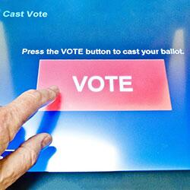
Other Rights as a Voter
Vote if you are a registered voter
Ask questions on election procedures
Vote in privacy and free from coercion or intimidation
Have non-discriminatory equal access to the elections system for all voters, including elderly, disabled, and minority, military, and overseas citizens
Notes:
Being equipped and familiar with information about their rights plays an important role in feelings of not only confidence but pride in taking part. And sometimes it’s just as simple as knowing they DO have rights and protections under the law! This plays a big role in a voter with a disability making their desire to take part in the process known.

Slide 28


Slide 29
Accepted Forms of Photo ID in MS for Voting
• A driver’s license • A government issued photo ID card • A United States passport • A government employee photo identification card • A firearms license • A student photo ID issued by an accredited Mississippi university, college, or community/junior college • A United States military photo ID • A tribal photo ID • Any other photo ID issued by any branch, department, agency or entity of the United States government or any State government • A Mississippi Voter Identification Card
Notes:
Other information voters need to be aware of: We require voter ID in MS.

Slide 30
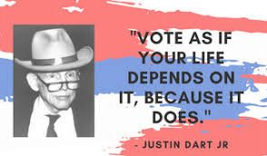

Notes:
For DRMS – voting rights isn’t just another program. It’s something we integrate into the activities we already do as part of our mission and commitment to healthier communities and a better society.
Informing and encouraging voters with disabilities to take part in their civic life is a first step in helping them realize their voice matters.

Slide 31

For further voting information and guidance, please visit this site from the DRMS web-site: http://www.votingrightsdrms.org/
Our next general election is being held on November 5th, 2019!
Go Vote!

